Slide 1
Regression Analysis
Simple Linear Regression
Nicoleta Serban, Ph.D.
Professor
School of Industrial and Systems Engineering
Regression Concepts: Estimation Example

Slide 2

About This Lesson

Slide 3
Example in R
A company, which sells medical supplies to hospitals, clinics, and doctor's offices, had considered the effectiveness of a new advertising program. Management wants to know if the advertising is related to sales. This company intends to increase the sales with an effective advertising program.
Which are the response and the predicting variables?
Y = Sales and X = Advertising Expenditure

Slide 4
Example in R: Estimation
Fit a linear regression. What are the estimated regression coefficients and the estimated regression line?
Interpret the coefficients.
What does the model predict sales as the advertising expenditure increases for an additional $1,000?
What sales would you predict for an advertising expenditure of $30,000?
What is the estimate of the error variance?
What could you say about the sales for an advertising expenditure of $100,000?

Slide 5
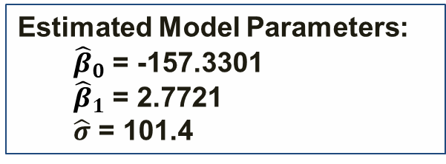
Example in R (cont’d)
## Read Data in R
data = read.table(“meddcor.txt", sep="", header = FALSE)
## Response & Predicting Variable
sales = data[,1]
adv = data[,2]
## Fit a linear regression model
model = lm(sales ~ adv)
summary(model)
Coefficients:
Estimate Std. Error t value Pr(>|t|)
(Intercept) -157.3301 145.1912 -1.084 0.29
adv 2.7721 0.2794 9.921 8.87e-10 ***
Residual standard error: 101.4 on 23 degrees of freedom
Multiple R-squared: 0.8106, Adjusted R-squared: 0.8024
F-statistic: 98.43 on 1 and 23 DF, p-value: 8.873e-10
Estimated Model Parameters:
  ${\hat{β}}_{0}$ = -157.3301
  ${\hat{β}}_{1}$ = 2.7721
  $\hat{σ}$ = 101.4

Slide 6
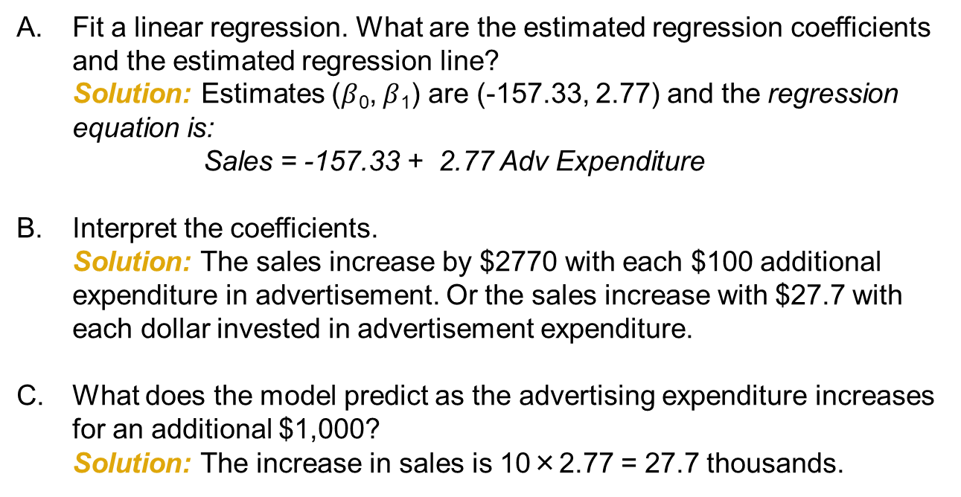
Example in R (cont’d)
Fit a linear regression. What are the estimated regression coefficients and the estimated regression line?
Solution: Estimates ($β$₀, $β$₁) are (-157.33, 2.77) and the regression equation is:
Sales = -157.33 + 2.77 Adv Expenditure
Interpret the coefficients.
Solution: The sales increase by $2770 with each $100 additional expenditure in advertisement. Or the sales increase with $27.7 with each dollar invested in advertisement expenditure.
What does the model predict as the advertising expenditure increases for an additional $1,000?
Solution: The increase in sales is 10×2.77 = 27.7 thousands.

Slide 7
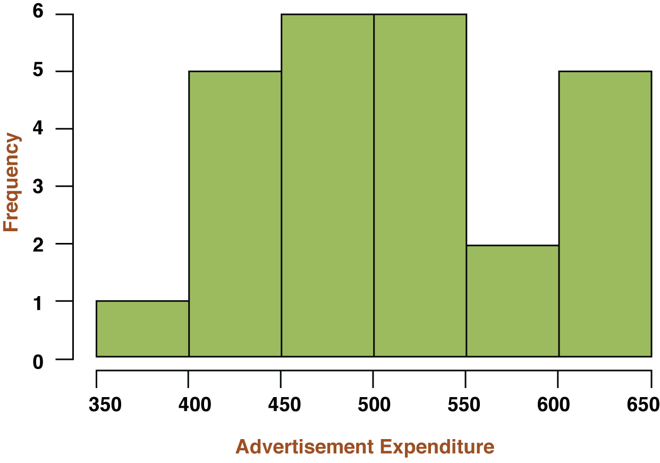
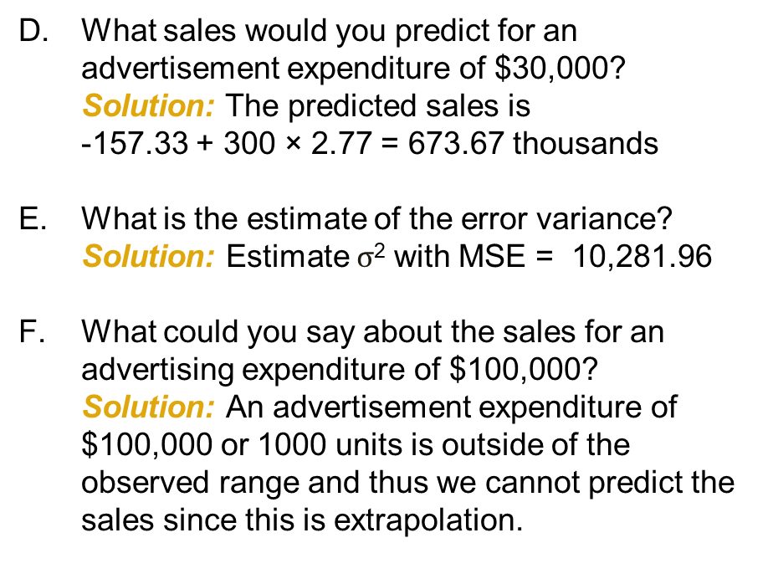
Example in R (cont’d)
What sales would you predict for an advertisement expenditure of $30,000?
Solution: The predicted sales is
-157.33 + 300 × 2.77 = 673.67 thousands
What is the estimate of the error variance?
Solution: Estimate $σ$² with MSE = 10,281.96
What could you say about the sales for an advertising expenditure of $100,000?
Solution: An advertisement expenditure of $100,000 or 1000 units is outside of the observed range and thus we cannot predict the sales since this is extrapolation.
Notes:
raymind

Slide 8

Summary

